Slide 1
The MOOC of One
Stephen Downes
INTED, Valencia, March 10, 2014

Slide 2
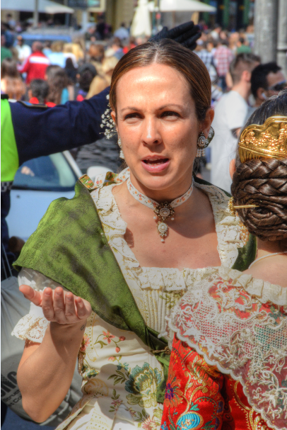
What is it to be ‘one’?
What is it do be one person?
What is it to be Valencian?
What is it to be a doctor?
We think of education as transforming a person into something, but what does that mean?
Do we even know?

Slide 3
Traditional Course
In the traditional course, we just throw content at people, and hope it sticks.
Traditional
Course
Website
Most online courses are based on content-based websites (even Coursera, Klan and Udemy)

Slide 4
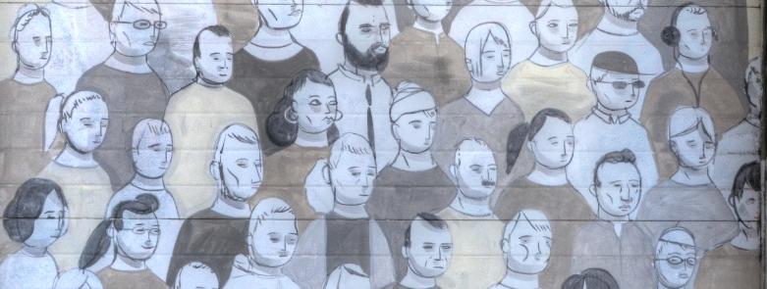
Is being ‘one’ being the same?
It is as though we felt everyone must have exactly the same content-knowledge to be a person, a Valencian, a doctor. But we know that’s not true.(*)
(*) This is an empirical proposition you can test for yourself.

Slide 5
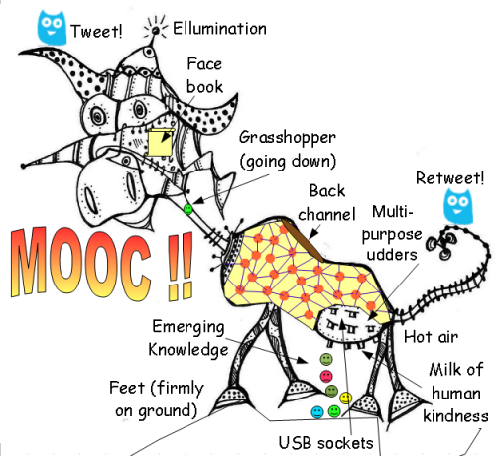
The MOOC
Massive – by design
Open – gratis and libre
Online – not blended, not wrapped
Courses – not communities, websites, video collections, etc
Image: Gordon Lockhart http://gbl55.wordpress.com/2011/03/08/cck11-man-this-mooc-is-something-else/

Slide 6
Massive Open Online Course
Site
A MOOC is a Web, not a Website

Slide 7
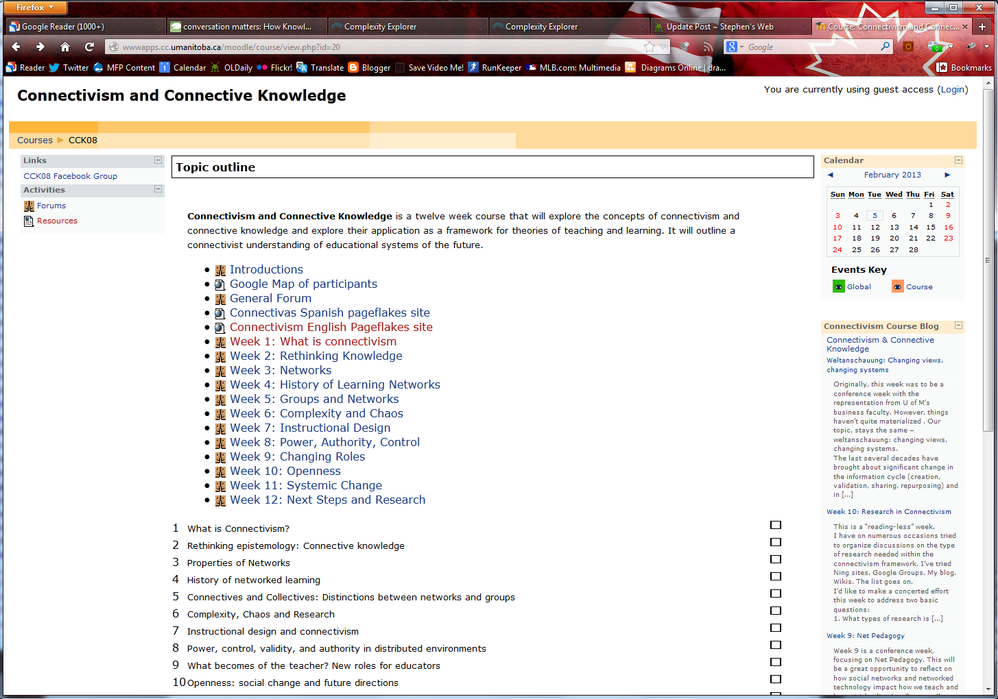
CCK08
http://wwwapps.cc.umanitoba.ca/moodle/course/view.php?id=20
2300 students
http://connect.downes.ca/cgi-bin/archive.cgi?page=thedaily.htm

Slide 8
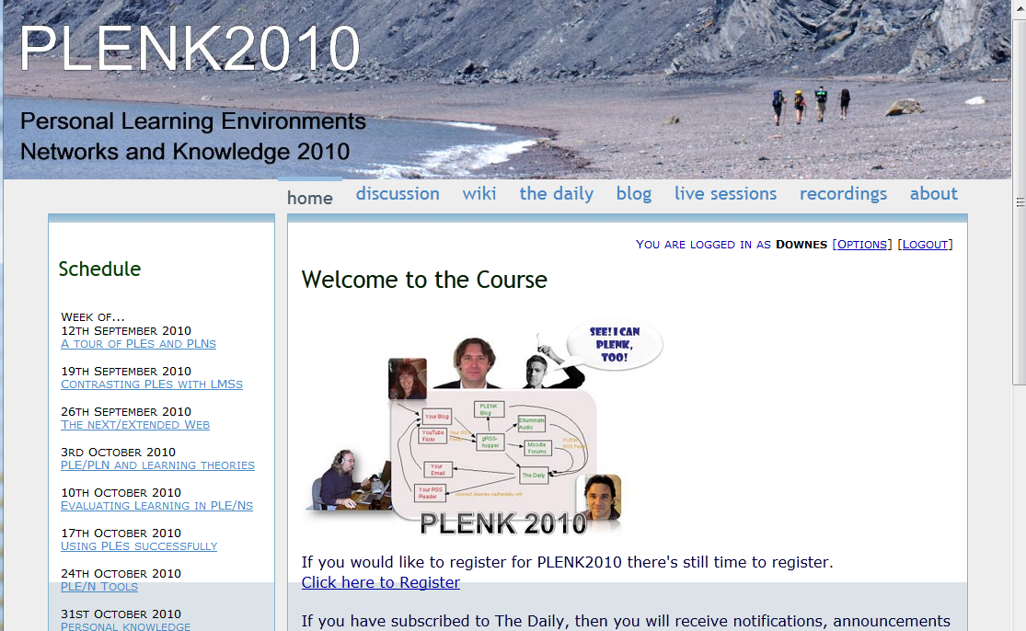
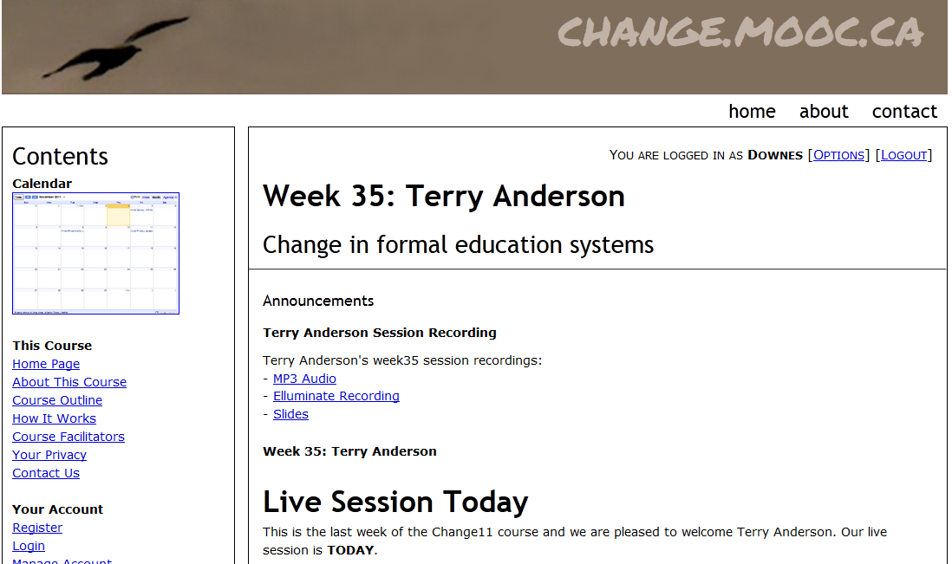
Other Courses
1800 students
http://connect.downes.ca/
2800 students
3000 students
http://change.mooc.ca/
http://edfuture.net/

Slide 9
Currently
MOOC REL 2014
http://rel2014.mooc.ca

Slide 10
Complaints, Complaints
Reading this course is like reading a dictionary
I can’t find specific content on something
Where does it tell me what to do?
There’s too much content to read
How do I know who to trust?

Slide 11
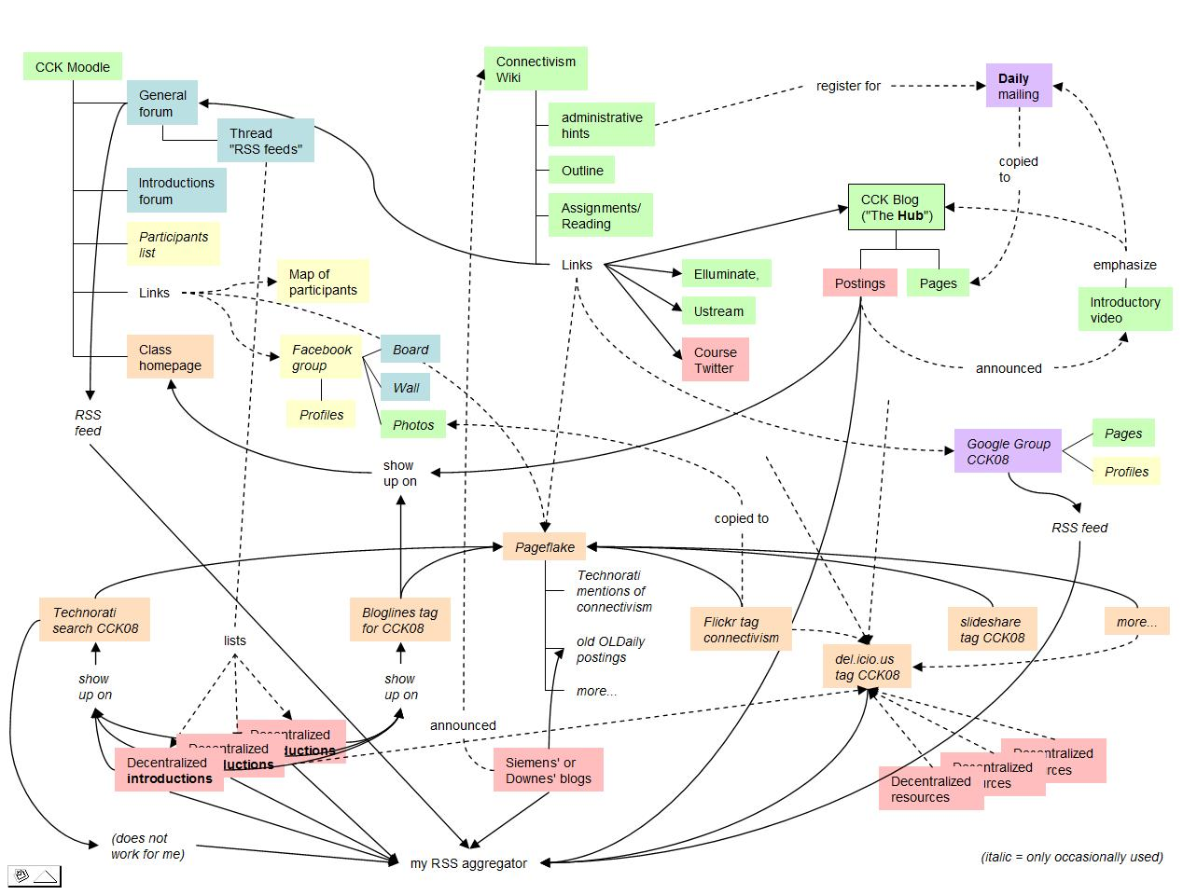
Connectivist MOOCs
http://x28newblog.blog.uni-heidelberg.de/2008/09/06/cck08-first-impressions/

Slide 12
What about process?
Operational – ‘one’ defined by reference to a series of steps or operations
Functional – ‘one’ defined by similarity of method, purpose or function
Teleological – ‘one’ defined by goal or objective

Slide 13
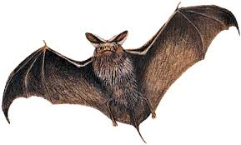
Having a ‘feel’ for it
But if you lose your place, how do you find your way back?
A basis in process is empty, soulless and mechanical
Thomas Nagel:
What is like to be a bat?
http://rintintin.colorado.edu/~vancecd/phil1000/Nagel.pdf

Slide 14
Creating the experience
Discovery learning, experiential learning
Constructionism, ‘making’
The idea is to create ‘one’ by creating the conditions that lead to being ‘one’
Kirschner, Sweller, Clark – Object that discovering some fact or principle is less efficient than being told what it is. Dismiss experience as irrelevant.

Slide 15
Underlying MOOC Support
1. First student creates resource and sends info to course
Site
2. Second student sees resource info in newsletter and RSS feed
3. Second student accesses the resource directly
4. Second student finds link to third student’s resource

Slide 16
Course Provider Perspective
Subscribed
students
Student
content
Site
Course
content
Live online events
Event recordings

Slide 17
The fleetingness of feeling?
Where do our memories go when we’re not having them?
Are we still a doctor when we’re asleep?

Slide 18
The semiotic approach
The Big Answer – we turn the camera outward and look at the world
Social constructivism
Empiricism and logical positivism
The Little Answer – we turn the camera inward and look at the world introspectively
The primacy of reason
The critical (digital, or whatever) literacies approach
These are semiotic approaches, based on the idea of reason and representation

Slide 19
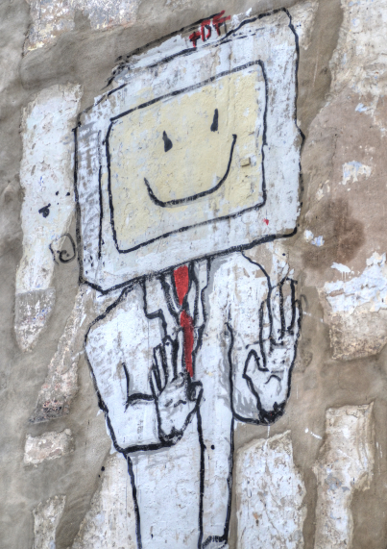
Take away the homunculus
There is no camera
There is no little man
There is nobody to ‘construct’ our representations for us

Slide 20
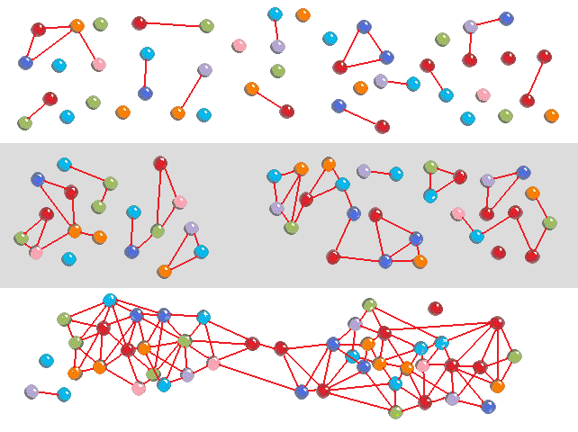
Self-Organizing networks
These are at once perceptual systems and reasoning systems

Slide 21
Design Principles
Autonomy
- Choice of contents
- Personal learning
- No curriculum
Openness
- Open access
- Open content
- Open activities
- Open assessment
Diversity
- Multiple tools
- Individual perspective
- Varied content
Interactivity
- Encourage communication
- Cooperative learning
- Emergent knowledge

Slide 22
Personal Learning
http://dmlcentral.net/blog/howard-rheingold/diy-u-interview-anya-kamenetz
http://www.downes.ca/post/58150
Notes:
Howard Rheingold searches for the new in Anya Kamenetz's Edupunk's Guide, suggesting that what has been added is the idea of the personal learning plan to the personal learning network. "Making a public commitment to something is going to increase your accountability," says Kamenetz. Rheingold writes, "Her work serves as a bridge between blended learning and peeragogy. I previously wrote about Shelly Terrell and personal learning networks" and asks here what it takes for a group to self-organize. Kamanetz responds that there needs to be a common understanding of the goal - of course, this would be the outcome of self-organization, not what makes it possible.

Slide 23
The Student’s Perspective
Site
A range of different resources and services

Slide 24
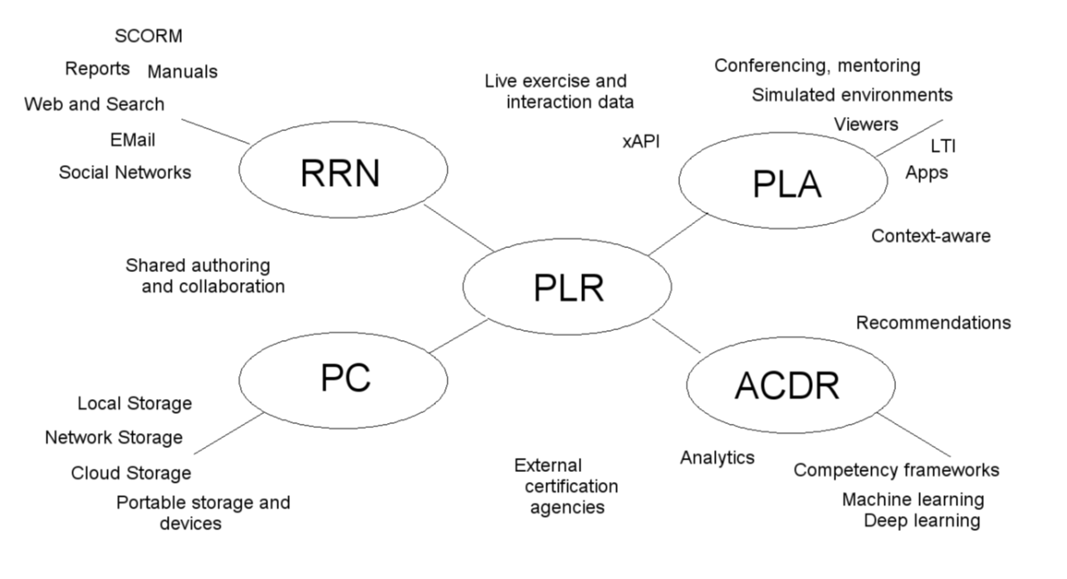
LPSS core technologies

Slide 25
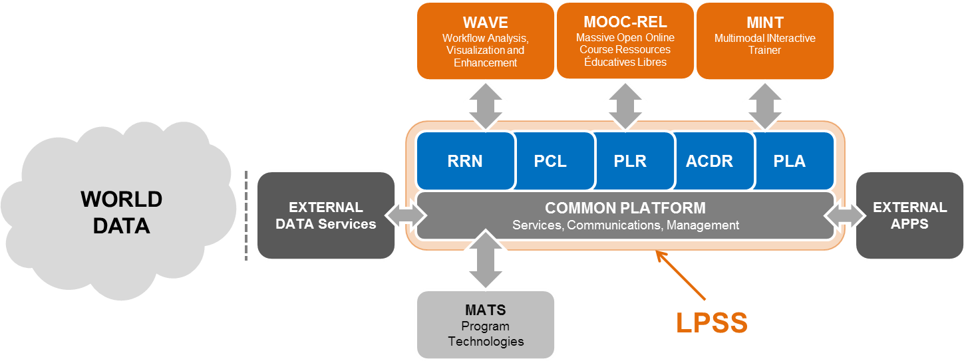
Learning and Performance Support
http://halfanhour.blogspot.com.es/2013/12/learning-and-performance-support-systems.html
http://www.nrc-cnrc.gc.ca/eng/solutions/collaborative/lpss.html

Slide 26
To be is to ‘know’
Where ‘knowing’ is in the sense of ‘recognizing’

Slide 27
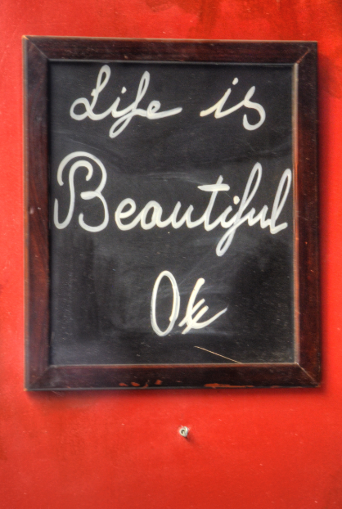
To be ‘one’ is to be you
The emphasis on the MOOC has always been on the ‘massive’ – but what makes the MOOC special is that for each person taking a MOOC, it is essentially the work of the one. Yourself.

Slide 28
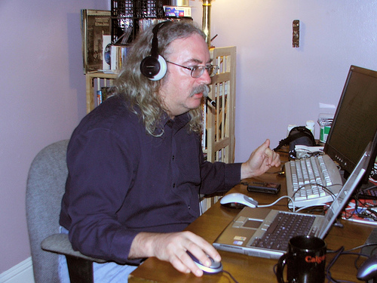
http://www.downes.ca

